Slide 1
A Level Computing Unit 1 – Programming Paradigms
Lesson : OOP – Object Oriented Programming

Slide 2
OOP Basics
Your first object oriented program
When you create a new Console Application project – you should see the following in the code editor
We don’t want to add anything in sub main just yet so add the following code just underneath End Sub:

Slide 3
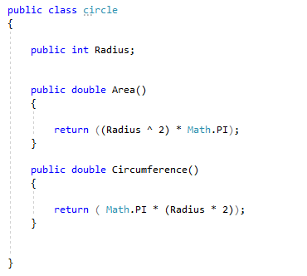
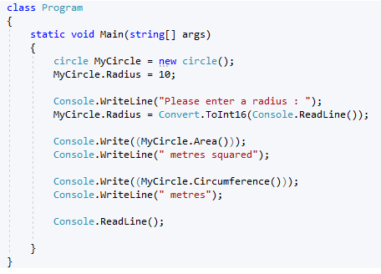
NOTE : Variables and properties are known as DATA MEMBERS and functions and procedures are known as METHODS
Now we need to write something which will allow us to use the class we have just created.

Slide 4
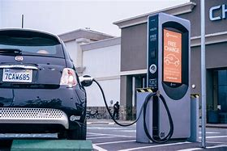

Connect – Car Tax System
Can you create a program to Input the details of a user and their car and then output the amount of tax they will be required to pay based on the cars Vehicle Emissions.
Properties:
Car Model
Car Make
Fuel Type – Petrol or Electric
Emissions – 0 to 100
Methods
CalculateTax
if car is electric then tax will be £0
If car is not electric then car will be charged £200 if emissions are above 50, otherwise the charge will be £120

Slide 5
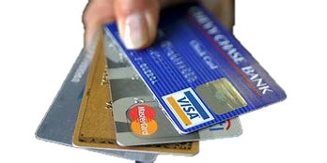
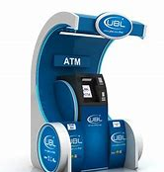
Connect – Banking System
Can you create a OOP program to hold the details about a bank account, and then to be able to mange the account using some basic methods
including:
Properties:
Bank Acc Number
Account holder name
Balance
Methods
Deposit funds
Withdraw funds
Print Balance

Slide 6
Connect – Crypo wallet
Can you create a OOP program to handle the operations needed to handle a crypto currency transaction. The program should allow users to view their balance and transfer funds to other accounts.

